Slide 1
‘OxySource’
Team Code Cops
Contributors
Devansh Panda
Kuldeep
Shubham Sahay(L)

Slide 2
Index
Idea/Problem Statement
Proposed Solution
Implementation
WAO! factor
Future Work
Thank you.

Slide 3
IDEA
Code Cops are en-route to build a project named ‘OxySource’ which contains all resources related to Oxygen agencies at one place.
Basically, it is a website which will help people to find out fully verified addresses andcontacts of oxygen suppliers.

Slide 4

OxySource
IDEA
Code Cops are en-route to build a project named ‘OxySource’ which contains all resources related to Oxygen agencies at one place.
Basically, it is a website which will help people to find out fully verified addresses and contacts of oxygen suppliers.

Slide 5
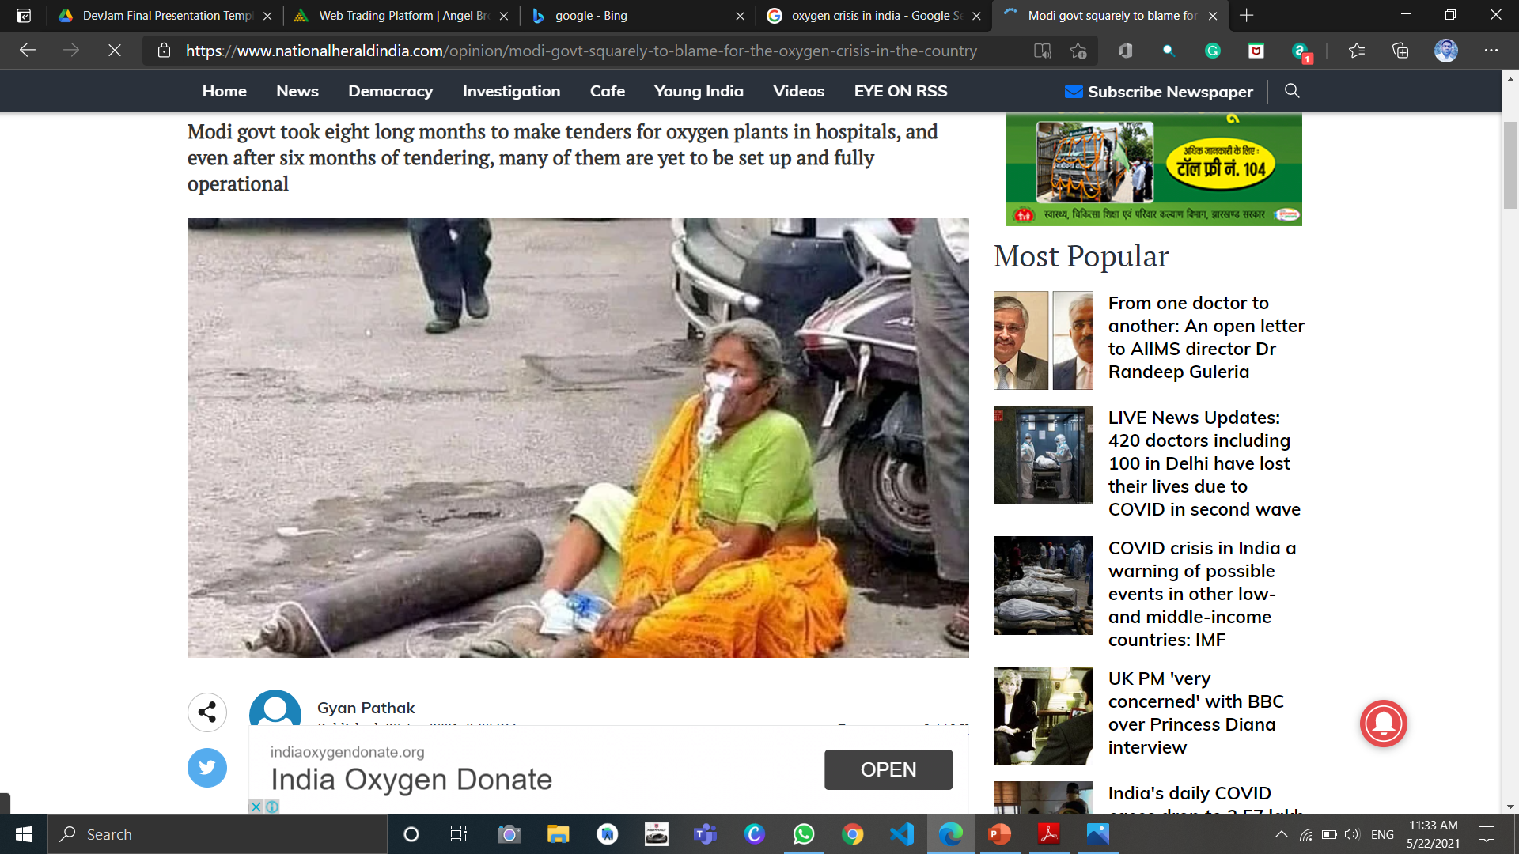
Problem Statement
With this initiative, we are hoping to resolve the problem of oxygen shortage in just single click.
India is suffering the fate of COVID and Oxygen crisis is one of its deadly outcomes.
Nowadays, deaths have been common not due to COVID but from oxygen shortage.
Currently, it will cover the districts of Uttar Pradesh but we wish to cover entire India if we get motivating responses further.

Slide 6
Implementation
We have used HTML, CSS and Java Script to turn our project into reality.
Cascading Style Sheets are used to accompalish most of the stylings and increase the responsiveness.
We have used ‘github’ to host our website.

Slide 7
WAO! Factor
Responsive
This website is very responsive.
Online Oxygen
One can also buy oxygen cylinders via online through any of the two link provided below the table.
Bookmark
No need to worry about the long tables. We have added a bookmark feature in Nav Bar which allows a user to reach the respective city in just a click.
Then the cylinders will be delivered at your door-step.
All the stacks are aligned in such a way to accommodate all the possible variations.

Slide 8
Future Works
As per the reports of WHO, a third wave is still on the way to hit India. This time, small children would be affected the most.
We have tried to cover all red-zone districts of Uttar Pradesh. But if we get motivating responses, will try to expand the reach of OxySource to other states, too.
Besides COVID-19, Oxygen cylinders can also be used for other medical-emergency purposes.
Thank You

